Slide 1
Reference Books
1) Object-oriented Modelling and Design
Author: M. Blaha, J. Rumbaugh
2) Software Engineering, ^{6th} edition
Author: Lan Sommerville
3) Software Engineering
Author: Roger S. Pressman

Slide 2
Design Concepts
Design
It is the phase of SDLC where creativity rules
During design, customer requirements, business needs, and technical considerations all come together in the formulation of a product or software
Creates a model of the software by providing the detail about the software data structures, architectures, interfaces, and components that are necessary to implement the system.
Each of the elements of the analysis model is translated to the corresponding design model to create the four design models required for a complete specification of design.
See Figure

Slide 3
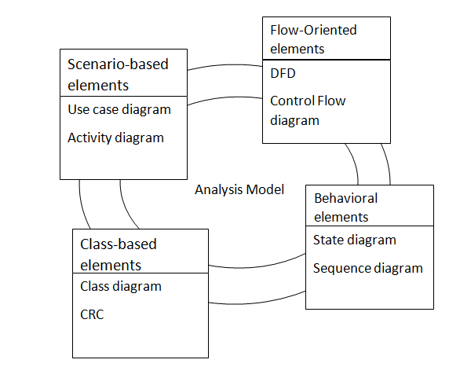
Component level Design
Design
Interface Design
Architectural Design
Data/Class Design
Design Model

Slide 4
Design Concepts
Software Design
It is an iterative process through which requirements are translated into a blueprint for constructing the software
The design is represented at a high level of abstraction
Quality Design features
Design should exhibit an standard architecture
It should be modular
Should contain distinct representation of data, architecture, interfaces, and components
Should lead to components that lead to independent functional characteristics
Should lead to interfaces that reduces complexity
and many others.
SOLID Design Principles

Slide 5
Design Model
Design concepts
Abstraction: procedural and data abstraction
Architecture: represents the overall structure of the software, and the conceptual integrity of the system
Patterns: describes a design structure
Modularity: the property that establishes that software is divided into separately named and addressable components called modules
Design Model
It can be viewed in two different dimensions: i) process dimension ii) abstraction dimension
Each of the UML diagrams used in analysis model is elaborated in the design phase, more implementation specific detail are added, architectural structure and style, components are emphasized.
See Fig. 9.4

Slide 6
Design
Design Types
Data/Class design
Architectural design
Interface design
Component level design
Software Quality attributes
Functionality is assessed by evaluating the feature set and capabilities of the programs
Usability is assessed by considering human factors, aesthetics, consistency and documentation
Reliability is evaluated by the frequency and severity of failure, the accuracy of output results, the mean-time-to failure, the ability to recover from failure and the predictability of the program.
Performance: Processing speed, response time, resource consumption, throughput and efficiency.
Supportability

Slide 7
Architectural Design
Software Architecture
The software architecture of a program or computing system is the structure or structures of the system, which comprise software components, the externally visible properties of those components, and the relationship among them.
Considers two level of design:
  Data design: focuses on the design of data structure, data bases, data warehouses
  Architectural design
Architectural Design
Large systems are decomposed into subsystems to provide some related set of services
The initial design process of identifying these sub-systems and establishing a framework for subsystem control and communication is called architectural design.

Slide 8
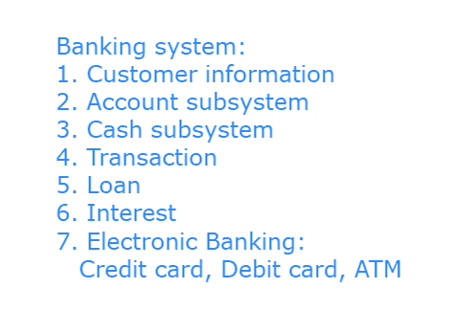

Slide 9
Architectural Design
Activities of Architectural Design
System structuring: The candidate system is structured into a number of principal subsystems, and the communication between these subsystems are identified.
Control modeling: A general model of the control relationships between the parts of the system is established.
Modular decomposition: Each of the subsystems is decomposed into modules.
Representing Architectural Design
The software to be developed must be put into context, i.e, the design should define the external entities
Tasks:
  Representing the system in context
  Defining archetypes
  Refining the architecture into components
  Describing instantiations of the system

Slide 10
MVC
MVC Architecture
Model-View-Controller architecture is a Webapp architecture
  Webapp infrastructure model
  Decouples the user interface from the Webapp functionality and informational content
Model
Contains all application specific content,
processing logic: includes content objects, access to external data/information source
All processing functionality required by the end users
View
Contains all interface specific functions
Enables the presentation of contents
processing logic: includes content objects, access to external data/information source
All processing functionality required by the end users

Slide 11
MVC Architecture
Controller
Manages access to the model and view
Coordinates the flow of data between them
In a Webapp, the view is updated by the controller with data from the model based on user input
Fig. Schematic Architecture of MVC Model. P 581.
er
Controller
External Data
Browser
Model
Client
View
Server

Slide 12
MVC Model for Library System

Slide 13
Class Design
Class Design
The objective is to
  Complete the definitions of the classes and associations
  Design algorithms for operations
  Complete the definitions of the classes and associations
  It is a process of adding details and making fine decisions
  Flesh out operations, choosing algorithms and breaking
  complex operations into simpler operations
  It is an iterative process- we may need to add new operations,
  attributes, and classes
  Set up relationship between objects including changes to
  inheritance hierarchy
  Algorithm/Pseudocode for Class operation
  Debit()
  Get the cheque
  Verify Signature and Account details
  Verify amount to be withdrawn
  If enough balance, disburse money, update account
  Else reject cheque

Slide 14
Class Design
Steps of Class Design
Bridge the gap between high level requirements to low-level services
Realize use cases with operations
Formulate an algorithm for each operation
Recurse downward to design operations that support higher level Operations
Refactor the model for a cleaner design
Optimize access paths to data
Adjust class structure to increase inheritance
Organize classes and associations

